Slide 1
Day 42 – Theme, LotF, and Participial Phrases

Slide 2
Agenda
Warm up
Participial Phrases
Theme Notes
Group Practice
Story of an Hour
Closure

Slide 3
Objectives
Understand and identify theme as it is used in fiction.
Identify symbolic meanings in a text and utilize these to determine theme.
Homework:
Lord of the Flies Chapters 1-4 are due by Thursday 3/30.
LotF Quiz on Thursday!

Slide 4
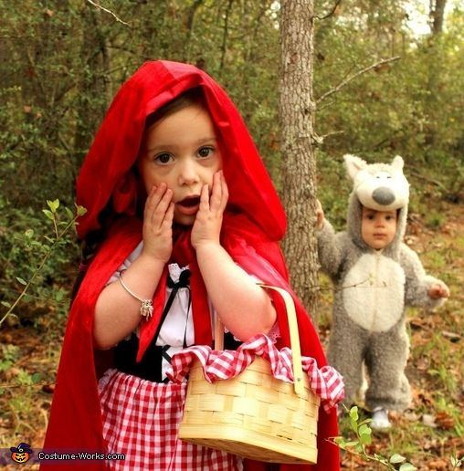
Warm Up - Theme
Write your definition of theme.
Using your definition, write down the theme from “Little Red Riding Hood”.

Slide 5
Participial Phrases

Slide 6
Participial Phrases
Remember, participial phrases include:
The participle (verby word that acts as an adjective)
Anything that modifies the participle (prepositions/adverbs)
In your pairs, work on the Participial phrases #2 worksheet. This is located under the worksheet from last class.

Slide 7
1. The umpire delayed the game because of the weather.
2. The delayed game will be played next week.
3. A growing child needs nutritious food.
4. Wild flowers were growing by the roadside.
5. You will find the information on the following pages.
6. Someone has been following me for the last block.
7. Some spots are becoming worn.
8. That dress is a very becoming color.
9. This restaurant has an interesting but limited menu.
10. My parents have limited my nights out to weekends.

Slide 8
1. Marilyn wished on the falling star.
2. Keith is the leading hitter on our team.
3. The detective had a puzzled expression on his face.
4. Can you repair this broken vase?
5. My favorite dessert is baked apples.
6. Marc auditioned for the casting director.
7. The dry cleaner had a pressing appointment.
8. The sitter soothed the frightened child.

Slide 9
C. Underline the entire participial phrase, and highlight the word it describes. Just because a word ends in –ing, -ed, -en, or –t, that does not mean it is the participle. It could be the verb!
1. The train arriving at track 10 is an hour late.
2. A first-edition book signed by the author may become valuable.
3. Looking hot and tired, the tennis players rested in the shade.
4. All of the seafood cooked in that restaurant is from Alaska.
5. Found in an abandoned barn, the painting was in excellent condition.
6. Mandy is the girl passing out the programs.
7. Anyone wanting to get an application may get one in the office.
8. Frightened by the horror movie, the child had nightmares for weeks.

Slide 10
Theme in Fiction

Slide 11
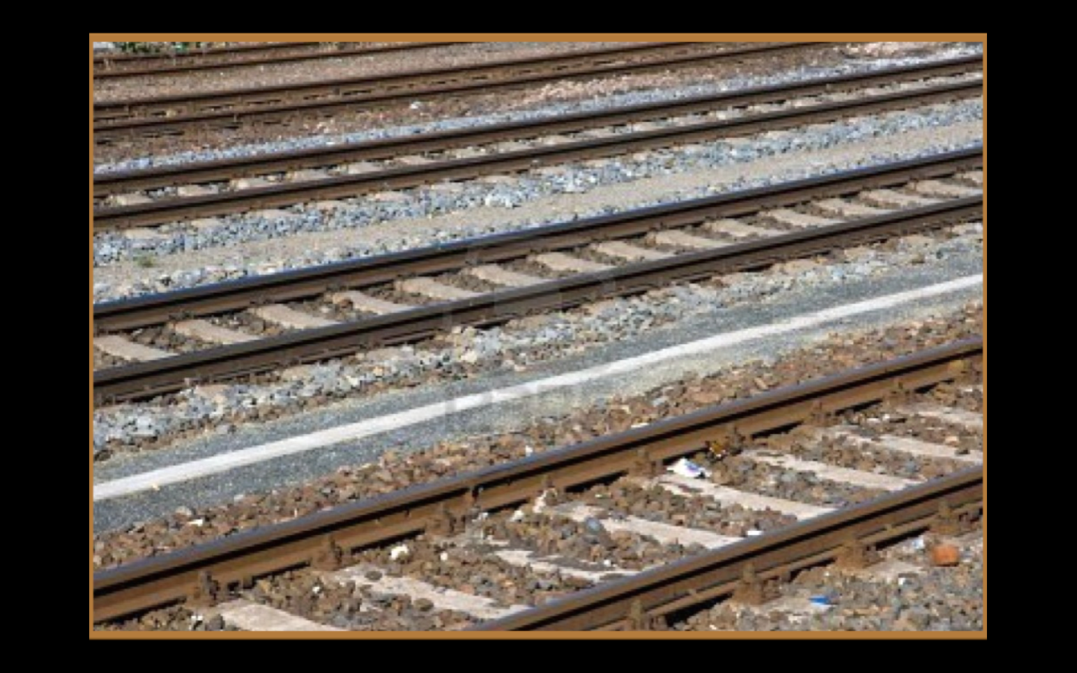
Good readers can identify the THEME of a fictional story.

Slide 12
REVIEW….
The five literary elements found in fiction
1. Characters : who
2. Setting: where/when
3. Plot: how –
4. Conflict: what
5. THEME: WHY

Slide 13
Theme
A theme is...
–The author’s central message or idea in a story. –Expressed in a general statement.
–Is about human beings or about life.

Slide 14
A theme is...
• A message or idea
• Stated in a sentence
• An author’s observation about human nature.
• Found in all literary elements of a story: characters, setting, plot, and conflict.
• Arguable.
Implied; not directly stated.
• Applicable to multiple texts.
• Example:
Hard work results in success.
A theme is NOT...
A moral
A lesson
Advice
A “you” statement
Fortune cookie message
One word
A summary
Non-example:
“Slow and steady wins the race.”

Slide 15
Theme
The theme is a generalization about life, but it should not be larger than the terms of the story (some, sometimes, may are more accurate than every, all, always).
Every detail and character action must contribute to the theme.
There is no one way to state the theme.

Slide 16
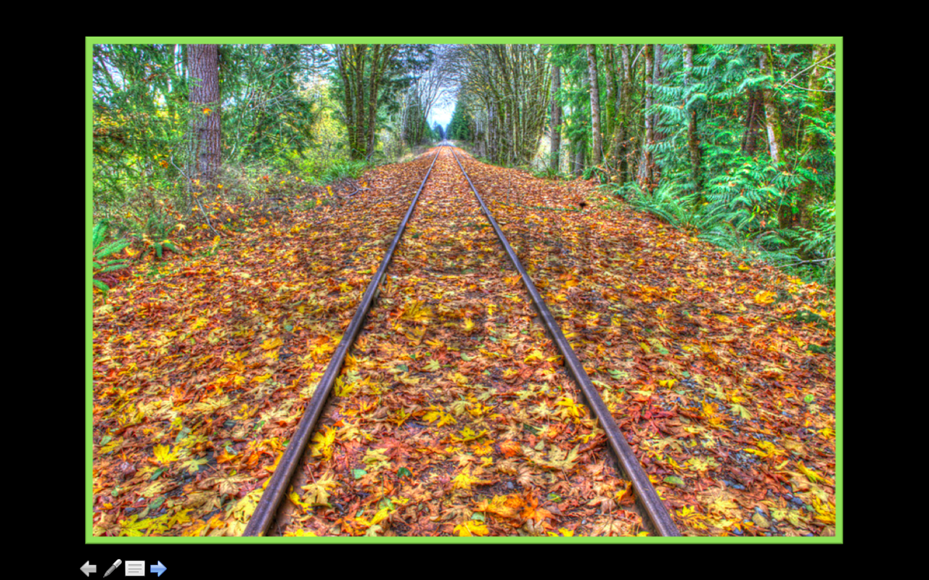
Have you read a book with one of these themes?
There is beauty in simplicity
Death is unavoidable
Loneliness is a destructive force
Knowledge is power
Ignorance is weakness
Love is transformative
Relationships are dependent on sacrifice

Slide 17
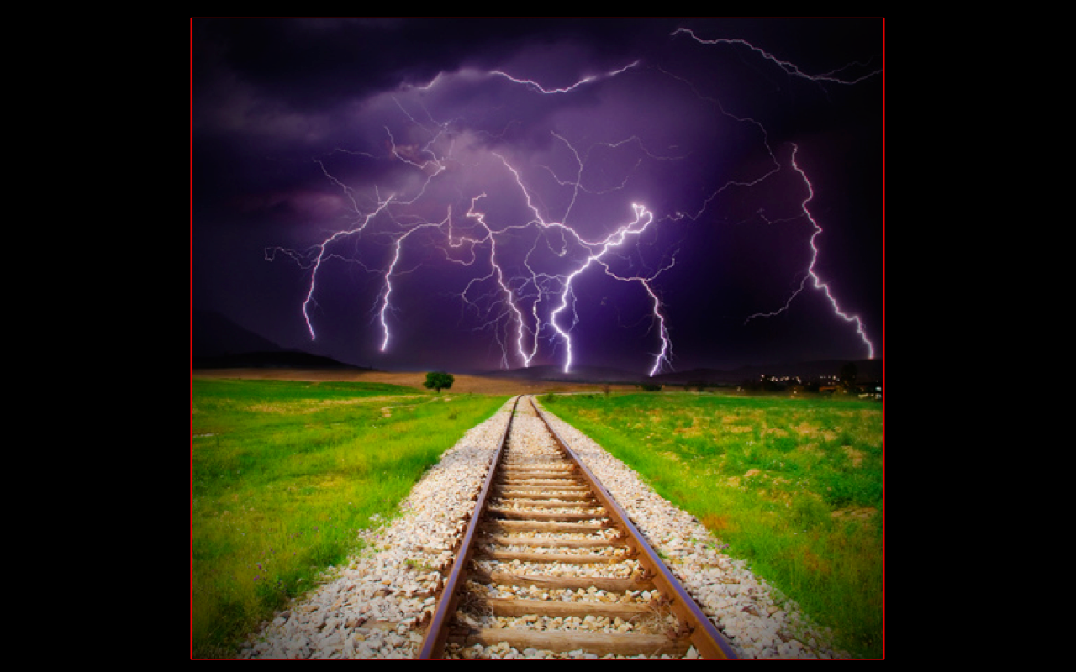
BIG IDEAS:
Ambition •Perseverance
• Jealousy • Fear
• Beauty • Prejudice
• Loneliness • Freedom
• Betrayal • Suffering
Loyalty • Happiness
• Duty •Redemption
• Truth • Love

Slide 20
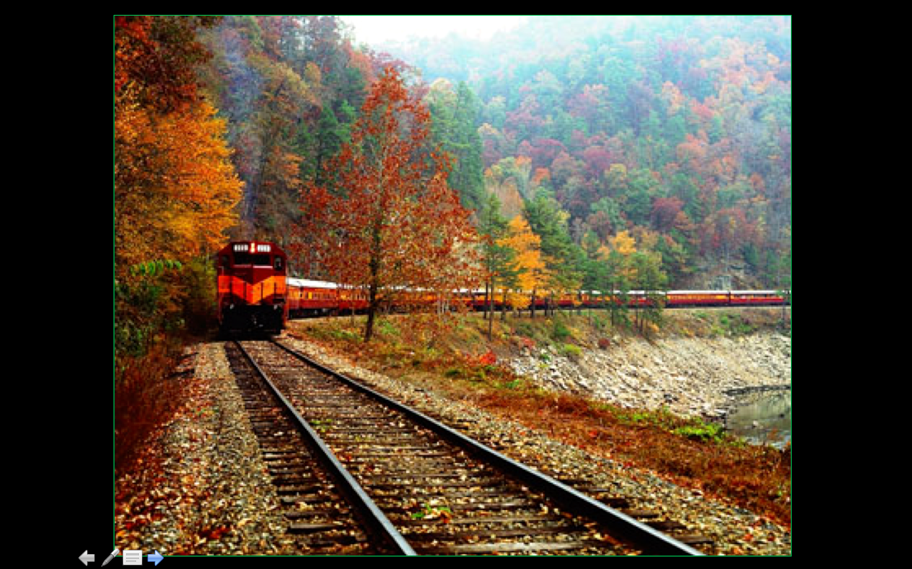
Still having trouble? Think about...
• Symbols that reoccur
• Patterns in the story
• Details that stand out from the rest
• The title

Slide 21
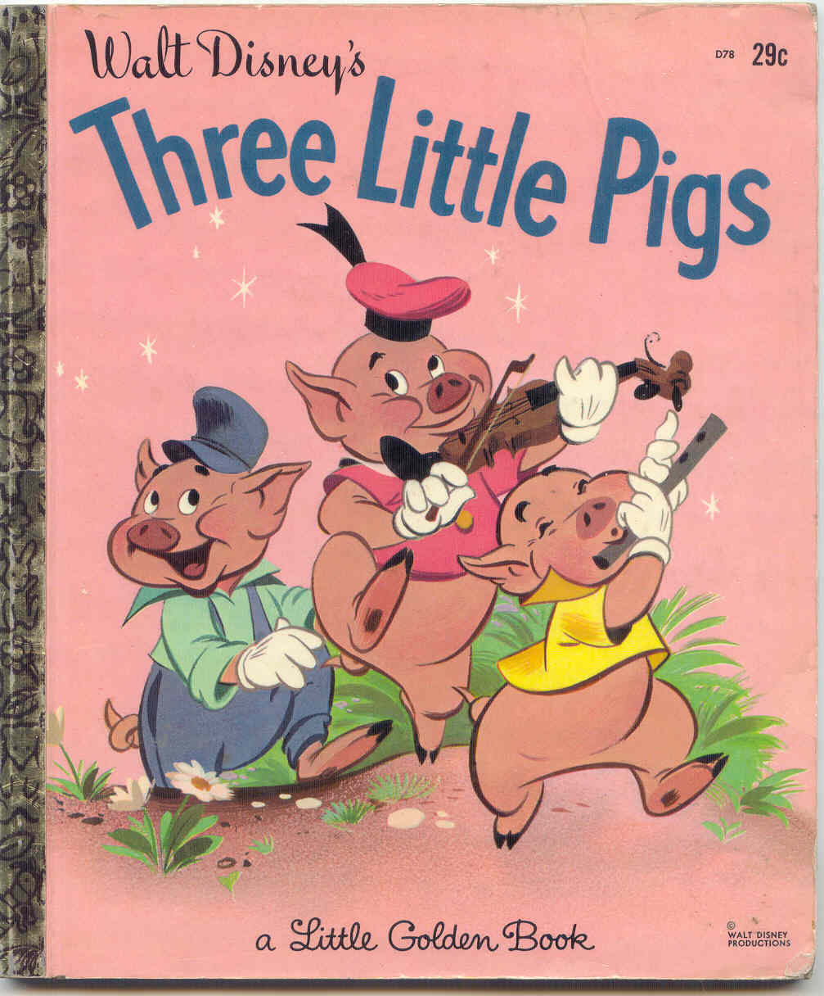
Possible Theme Statements for The Three Little Pigs
Work hard for success.
Hard work will eventually lead to positive outcomes.
Work hard the first time and get the job done properly.
Ignorance can lead to deception.

Slide 22
Steps to Identifying Theme:
Read the title.
Does it reveal anything?
Does the meaning of the title change as you read the story?
2. Examine the details of the story and the bearing of the character.
What is the conflict?
How does the protagonist deal with the conflict?
3. Identify the tone of the story.
Analyze the author’s diction, details, imagery, and syntax.
Are there certain repetitions of words, phrases, actions, or events?
4. Analyze the resolution.
What is the author trying to say by ending the narrative this way?
How would the outcome change in an alternate ending?
What might the comparison suggest?

Slide 23
Group theme Practice

Slide 24
Jigsaw Theme
Get into your 4 person groups and spread out. I will assign each of you a number.
Read the story and answer the questions that correspond to your number. When you have finished, you will be teaching your section to your group.
DON’T BE A DRAG.
Fill in the answers from your classmates. Each of you will be submitting a completed worksheet for credit.

Slide 25
Theme individual Practice
The Story of an Hour

Slide 26
Read “The Story of an Hour”
And
respond to the questions in a Google doc

Slide 27
Lord of the Flies Time
Take out your LotF book and read. This is a good time to answer the study guide questions and annotate.
Based on our lecture, annotate for
symbolism in LotF.

Slide 28
Closure - 3,2,1
Write:
3 things you learned about symbolism today.
2 examples of Gerund phrases.
1 question you have regarding the lecture.

